Slide 1


COVID ERA CRIMES IN SF
View in Power BI
Last data refresh:
4/20/2021 6:14:57 PM UTC
Downloaded at:
4/20/2021 6:23:21 PM UTC

Slide 2
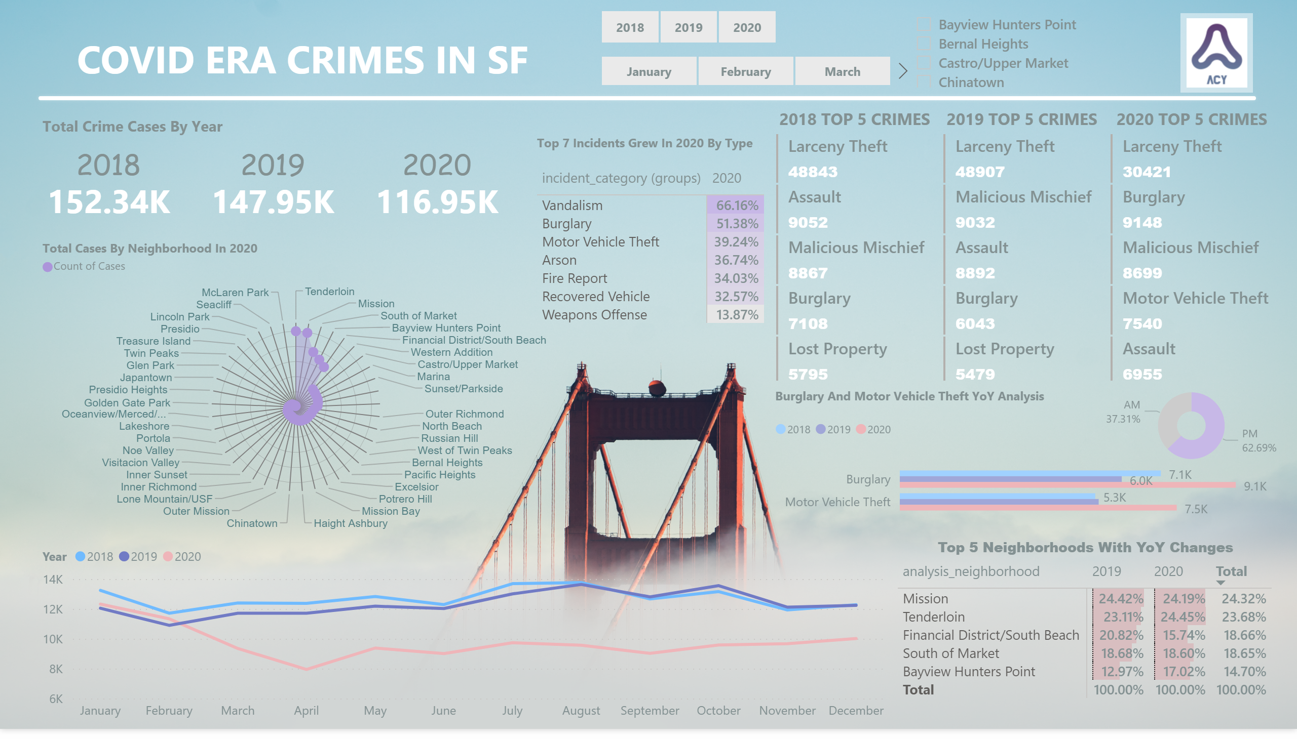
Summary
Notes:
shape
No alt text provided.
textbox
No alt text provided.
image
No alt text provided.
2020
No alt text provided.
2019
No alt text provided.
2018
No alt text provided.
lineChart
No alt text provided.
slicer
No alt text provided.
2018 TOP 5 CRIMES
No alt text provided.
2020 TOP 5 CRIMES
No alt text provided.
2019 TOP 5 CRIMES
No alt text provided.
Top 5 Neighborhoods With YoY Changes
No alt text provided.
textbox
No alt text provided.
slicer
No alt text provided.
donutChart
No alt text provided.
clusteredBarChart
No alt text provided.
textbox
No alt text provided.
Count of Cases by Neighborhood For 2020
No alt text provided.
textbox
No alt text provided.
slicer
No alt text provided.
pivotTable
No alt text provided.
textbox
No alt text provided.

Slide 3
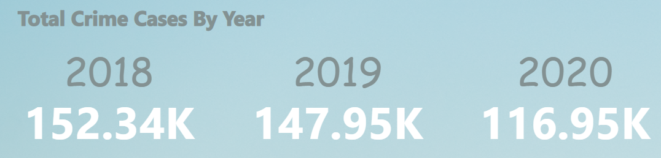

Slide 4

